Slide 1
Electromagnetic Projects to be Included in Technology Road Map

Slide 2
1. Reduce Motor Friction
Motivation (6)
Description
REPS gear w/reduced friction for certain premium customers (e.g. Ford CD6)
Motivation
To be competitive with other competitions offering low friction gear
Deliverables
Identify all components of friction budget/allocation
Reduce motor hysteresis by design /material selection
Si steel vs. other higher grade materials (Ni-Iron, Co-Iron etc.)?
Timing
Concept development and analysis / Selection : April 2015
Concept design and build complete : August 2015
Other exotic material selection decision : October 2015
Team Members/Customers
Alejandro, Rakib, Steve Collier-Hallman

Slide 3
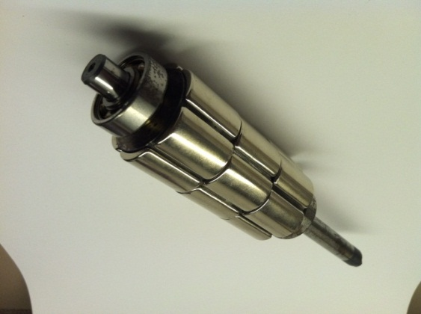
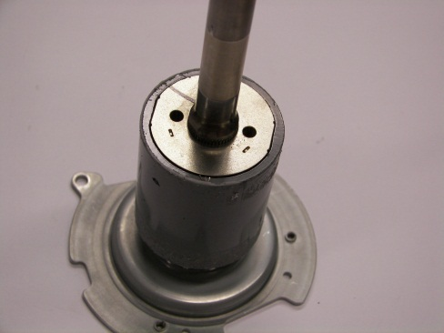
3. Segments / Ring Magnets?
Motivation (4)
Description
Gain better control on cogging and harmonics and reduce part to part variation . Learning cost trade offs
Motivation
Smaller motor using arc segments with multiple pieces per pole become challenging for making the magnets as well as placing on the rotor. Ring magnet solution can eliminate that challenge.
Deliverables
Cost study with magnet supplier-- Target program is BMW-30.5mm
Complete analysis for a 9/6 motor replacing 2-step skewed design by a ring magnet
Build motors based on the analysis for 20~30 mm long stack lengths (Say, FIASA)
Timing
Analysis : June 2015
Concept design and build complete: September 2015
Testing complete : November 2015
Further tuning of the design / decision : December 2015
Team Members/Customers
Subhra Paul, Rakib?

Slide 4
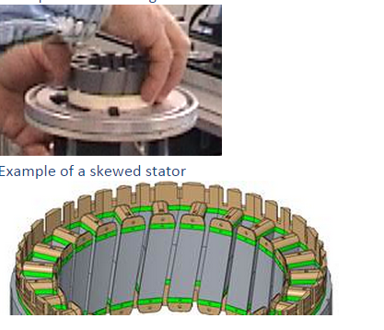
4. Skewed Stator-Alternate to Ring Magnet / Skewed Arc
Motivation (4)
Description
Gain better control on cogging and harmonics and reduce part to part variation . Learning cost trade offs
Motivation
Smaller motor using arc segments with multiple pieces per pole become challenging for making the magnets as well as placing on the rotor. To overcome the challenges in rotor skew when comes to a smaller magnet length skewed stator is one form of solution
Deliverables
Complete study with 9/6 motor w/ skewed stator
Build motors around 30~40 mm long stack lengths (Lamination from LH and wound by ATS), Target program is BMW—30.5mm
Timing
Ordering parts : June 2015
Concept design and build complete: September 2015
Testing complete : November 2015
Team Members/Customers
Robert Long, Sai, Alejandro

Slide 5
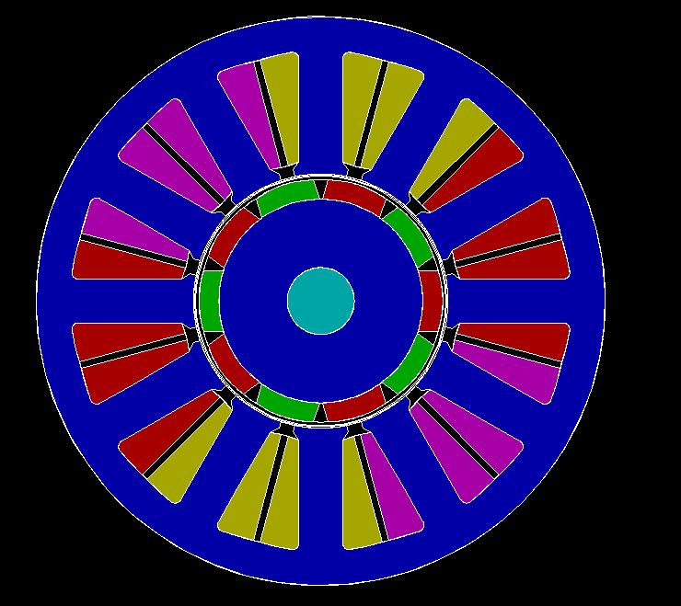
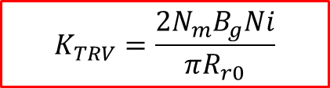
6. 12/10 Motor
Motivation (6.5)
Description
Optimize motor design by selecting motor topology
Motivation
Need to relook at this design as it is the highest torque density motor
Mechanical/structural work needed to address NVH tied to this motor topology?
Deliverables
Do a cost model of the current Honda Fit system first
Complete validation leveraging the 12-slot stator parts from 12/8 builds for a 12/10 motor
Idea of potted stator or any other concept to improve structural stiffness
Complete sizing comparison with 12/8 , 9/6 and 27/6 motor
Timing
Analysis : August 2015
Concept design and build complete: October 2015
Testing complete : December 2015
Team Members/Customers
Rakib, Subhra, Rakesh, Robert
$$K_{TRV}=\frac{2N_{m}B_{g}Ni}{πR_{r0}}$$

Slide 6
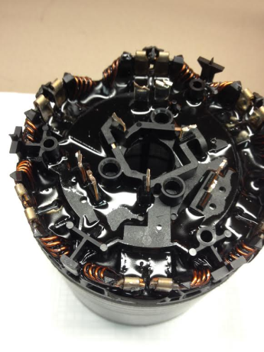
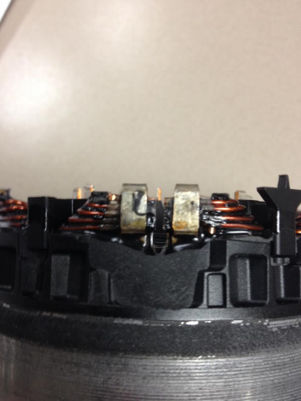
11. Needle Winding w/Multiple WIH
Motivation (4)
Description
With more WIH can enhance the capability of needle winding design to compete with shed / segment winding
Motivation
Making needle winding more of a scalable design
Deliverables
Complete comparative study on the BMW X3, X5 system
Come up with termination design scheme for more than 2 WIH
Proof of concept with prototype build (say, 12/8 motor)
Timing
Comparative study : June 2015
Concept of termination scheme : September 2015
Prototyping : November 2015
Testing & design decision : December 2015
Team Members/Customers
B. Williams, Chris

Slide 7
13. Automotive Electric Water Pump (EWP)
Motivation (5)
Description
Improve fuel efficiency by electric motor used for the water pump
Motivation
Initial assessment completed in the technology roadmap review meeting and found worth to pursue
Improve Engine management, pump efficiency
Improves Packaging (Compact in size).
Emission Improvement and reliability.
Accessories minimization
Deliverables
Performance data of Non Electric water pump
Design and Develop proto with minimum cost and improved performance of EWP
Timing
Analysis : June 2015
Further tuning of the design / decision : December 2015
Team Members/Customers
Subhra, AL Armitage, Steve Collier-Hallman, Sai Saagar

Slide 8
14. Electric Brake Booster
Motivation (5)
Description
Electric motor as brake boosting operation
Motivation
Initial assessment completed in the technology roadmap review meeting and found worth to pursue
Deliverables
Based on requirements complete motor sizing
Timing
Team Members/Customers
Brian Magnus, Sai, ??

Slide 9
17. Next Generation Position Sensor
Motivation (7)
Description
Develop position sensor for higher accuracy/resolution
Motivation
To improve position accuracy
To achieve better resolution as motor designs with higher poles evolved
Deliverables
Position sensor alternatives- a broad search
Analog/Digital/GMR/TMR ???
Sense magnet design / sensing technology selection
Timing
Analysis and design by Q4 2014
Procure components and build prototype by Q2 2015
Test and fine tune design end of Q2
Team Members/Customers
Ken Sabol, Steve CH, Paul Fisher,??,

